Slide 1

Dynamics CRM 2016
New Feature Review

Slide 2

Mitch Milam
Dynamics CRM Architect
Independent consultant
10–time Dynamics CRM MVP
Contact me:
mitch@xrmcoaches.com
Infinite–x.net
@mitchmilam

Slide 3
Future Events
Workshop: Dynamics CRM Administration and Maintenance (On Premises)
Wednesday, January 27th, 2016 at 1:00pm (Central Time US)
Webinar: Dynamics CRM Security 101
Friday, January 29th. 10:00am (Central Time US)
Webinar: Dynamics CRM Workflows 101
Friday, February 12th, 10:00am (Central Time US)
Workshop: Dynamics CRM Administration and Maintenance (Online)
Wednesday, February 17th at 1:00pm (Central Time US)

Slide 4
2016 Training Roadmap
Webinars
http://www.xrmcoaches.com/webinars
KnowledgeBits
http://www.xrmcoaches.com/knowledgebits
Learning Plans
Availability starting late–January 2016.
More Goodies
Books
Practice tests
On–Demand video training
Instructor–led training

Slide 5
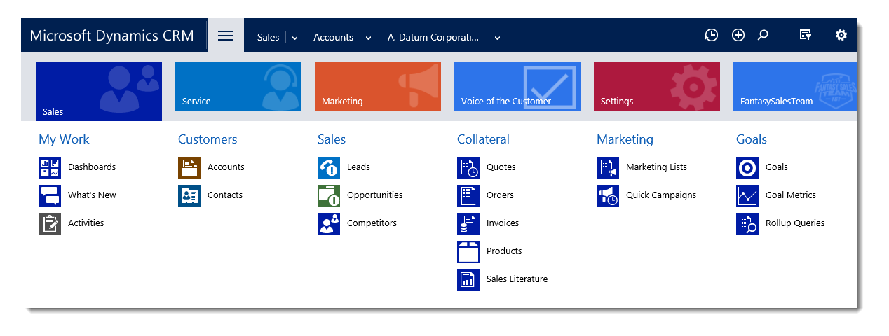
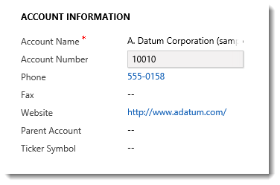
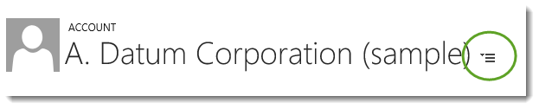
Productivity:
User Experience
ENHANCED
Updated Navigation
Improved field visibility
Tab selector
Notes:
Building a beautiful document based on CRM data is now simplified with Document Generation.
No longer need to manually extract CRM data for documents such as Account summaries, quotes/orders/invoices, product sheets.
Authors can build templates in Word using the native XML mapping pane. Once uploaded back into CRM, users can see the relevant templates available (role-based) and 1-click generate the document as a download.

Slide 6
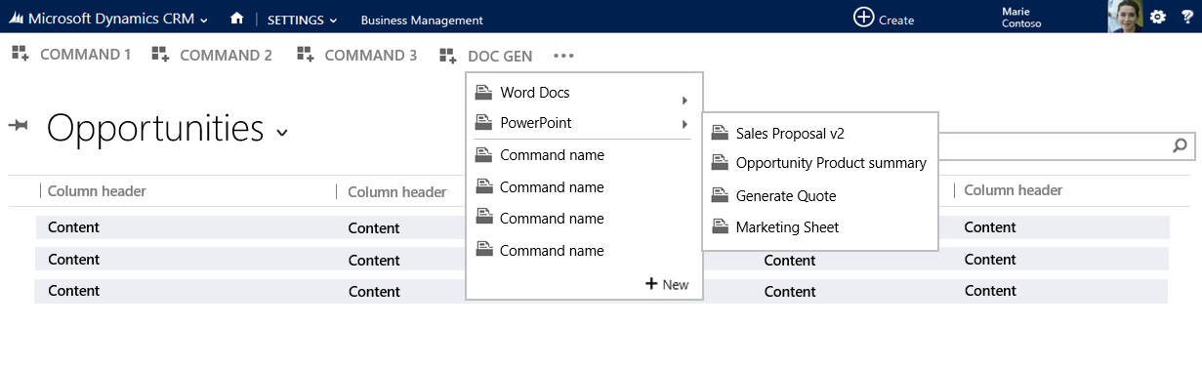
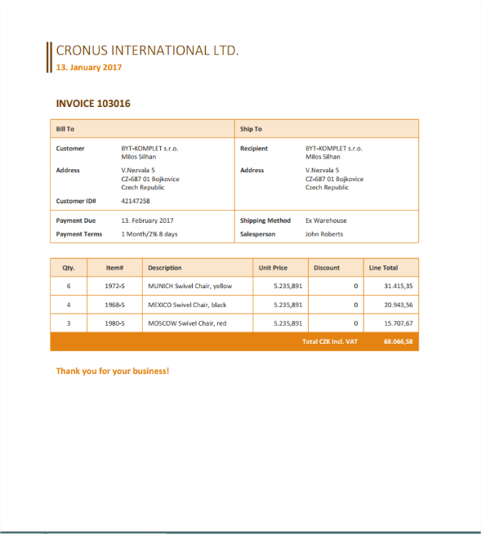
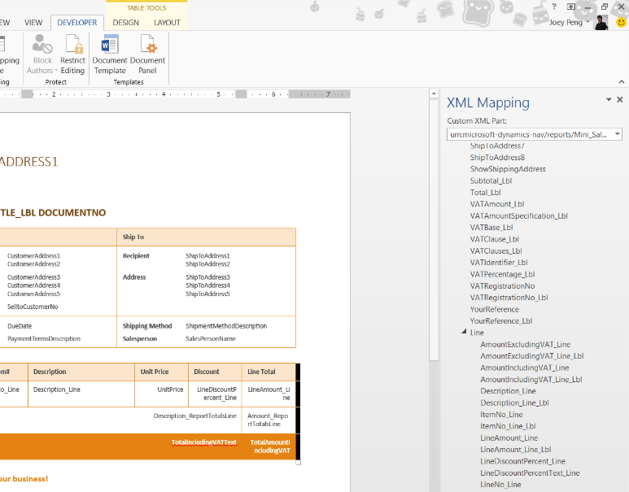
Productivity:
Document generation
NEW
Auto-generate formatted Documents based on CRM Records
Generate docs as part of a workflow
Create and edit Templates to achieve the desired document structure
Notes:
Building a beautiful document based on CRM data is now simplified with Document Generation.
No longer need to manually extract CRM data for documents such as Account summaries, quotes/orders/invoices, product sheets.
Authors can build templates in Word using the native XML mapping pane. Once uploaded back into CRM, users can see the relevant templates available (role-based) and 1-click generate the document as a download.

Slide 7
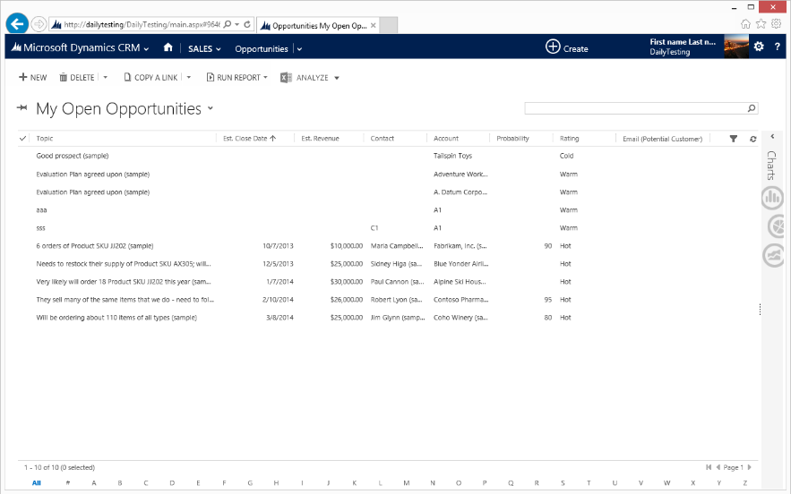
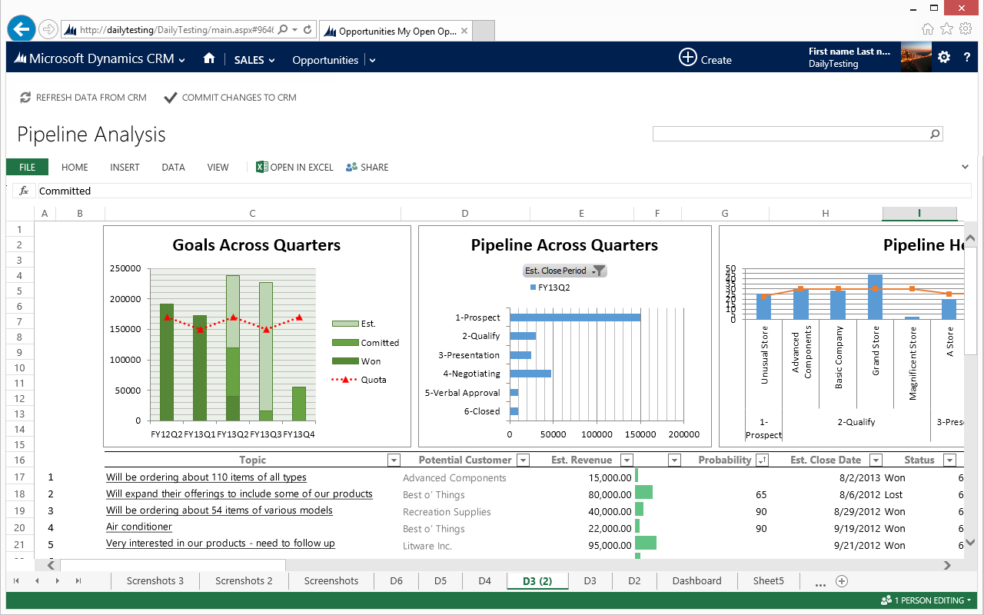
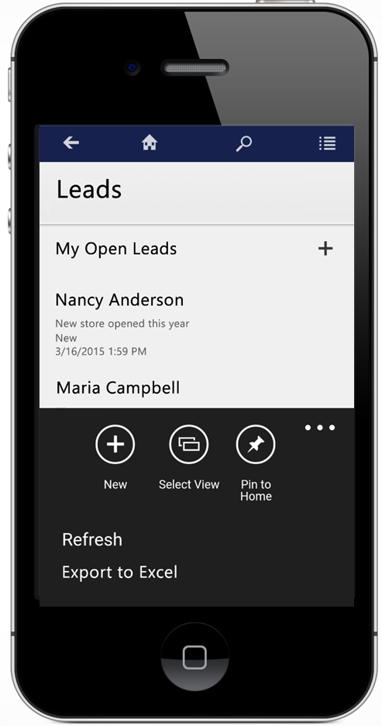
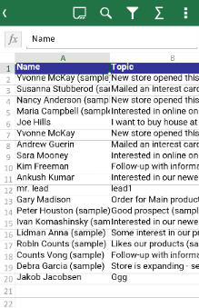

Productivity:
Excel Integration
ENHANCED
Pre-built templates
Private and Organizational templates
Share templates across team members
Export to Excel from CRM for Tablets and Phone
Notes:
Empower users to analyze data in CRM using familiar Excel capabilities via an immersive Excel experience in the CRM interface. Build and deploy templates for your entire organization to leverage as well as empowering your employees to develop their own templates which can be shared across team members.
Export and analyze data in Excel from your mobile device with added support for the CRM for Tablets and Phones apps.
The Immersive Excel capability is only supported for CRM Online. CRM On Premise deployments support exporting data to Excel.

Slide 8
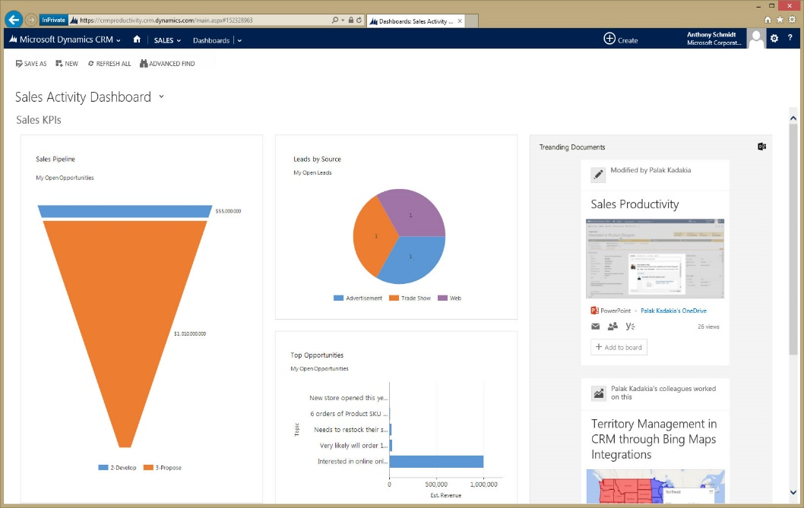

Productivity:
Information Discovery
NEW
Trending Documents
Delve
Notes:
Information comes to you by surfacing Trending Documents from Office Delve; find what you need; discover new connections on a dashboard in Microsoft Dynamics CRM.

Slide 9
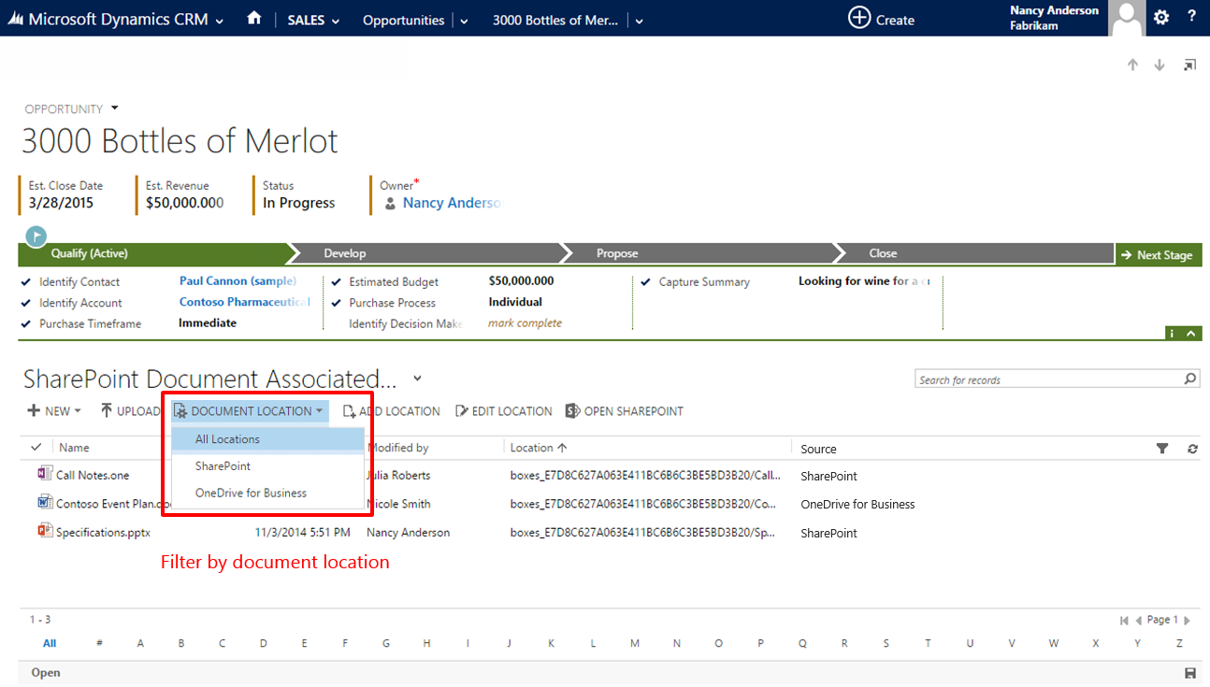
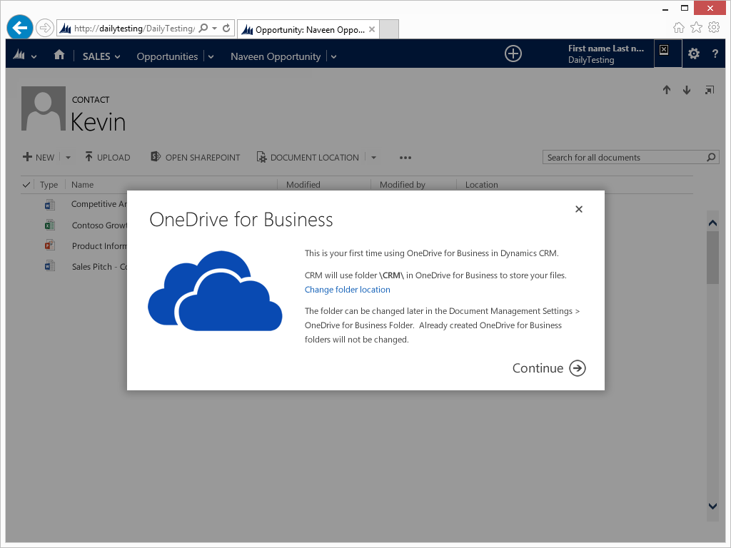
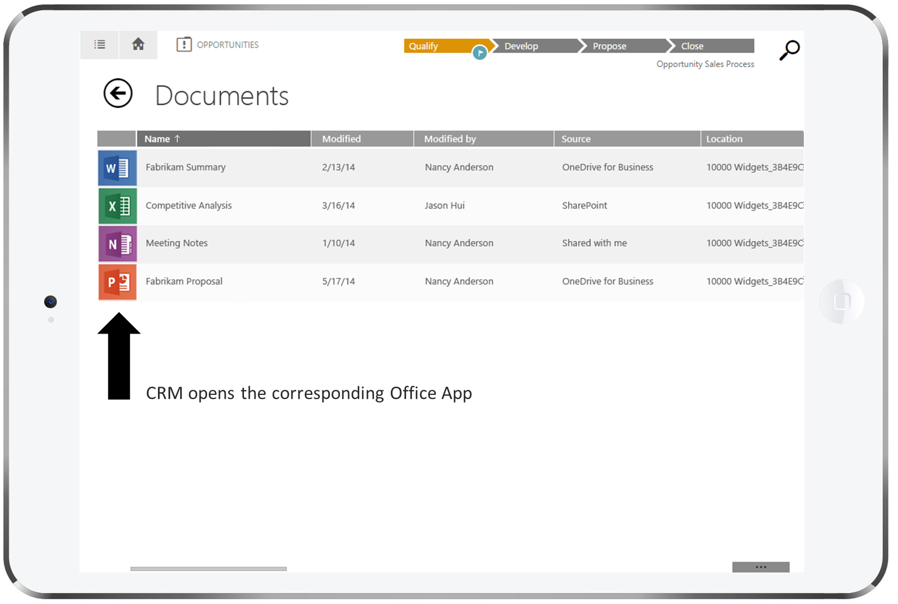

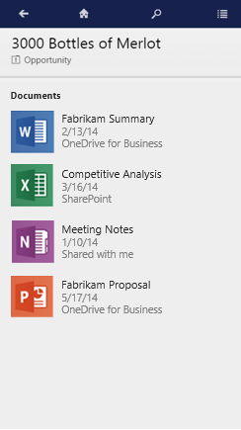

Productivity:
OneDrive for Business and documents
NEW
Private documents storage
All document sources in one place
Phone and tablet support for document management
Notes:
Get a consolidated view of contextual documents across SharePoint, OneDrive for Business, and Office 365 Groups for any CRM record.
Users can seamlessly open various Office apps within the CRM mobile app (tablet and phone) enabled through outbound mobile deep-linking. For example, you can open a proposal document in the CRM app using Microsoft PowerPoint for iPad or Microsoft Word for iPhone as illustrated in the screenshots. After reviewing the document, you can return back to the CRM app by just tapping on the “back” button.
Available for both CRM Online and CRM On Premise. OneDrive for Business is currently available in SharePoint Online and coming to SharePoint On Premise with SharePoint 2016.

Slide 10
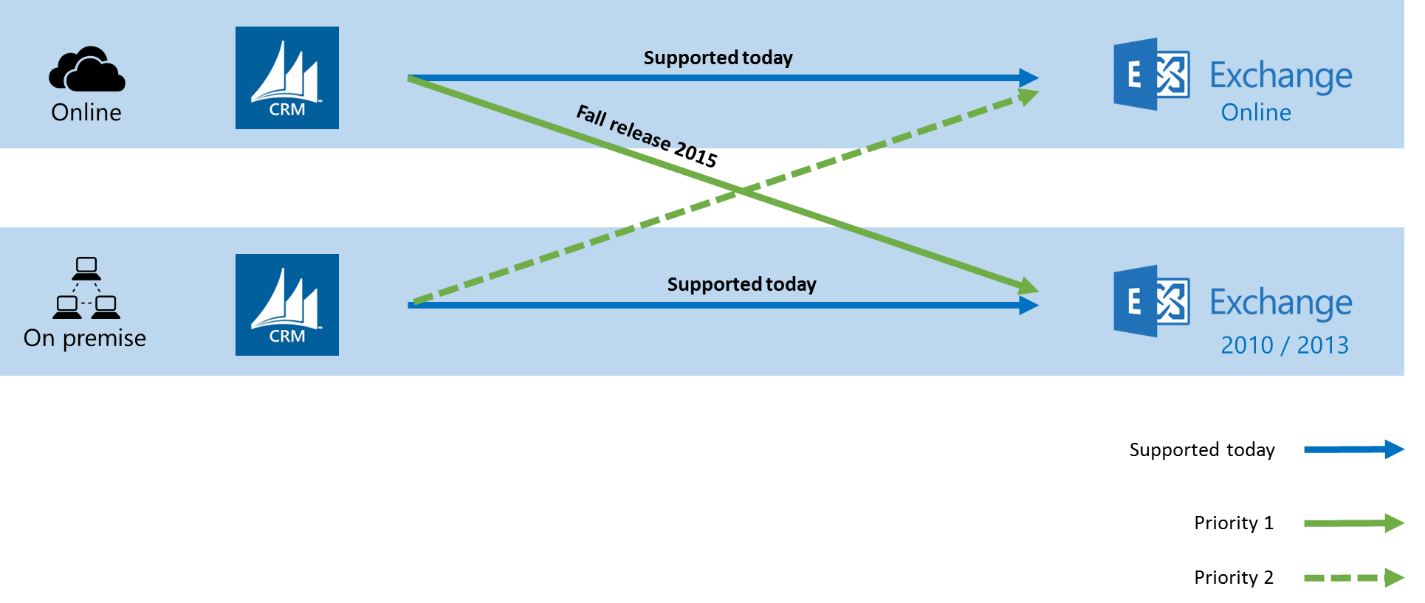


Productivity:
Server side sync & Outlook Client
ENHANCED
CURRENT
Hybrid Scenario
Support for Gemini and Windows 10
PLANNED
CURRENT
Notes:
The server side synchronization that enables sync of data between CRM and Exchange will introduce support between CRM Online and Exchange On premise.

Slide 11
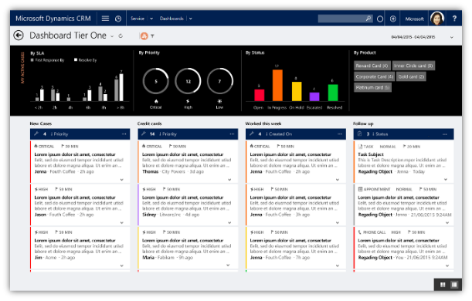
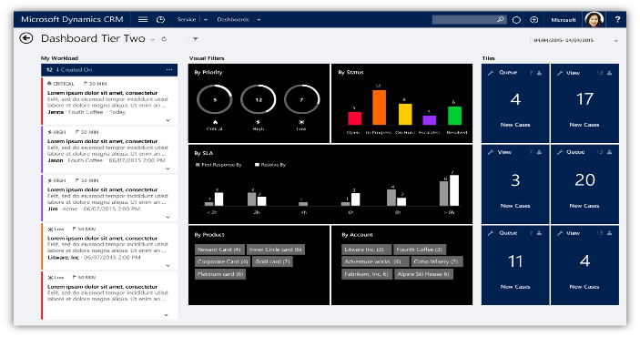
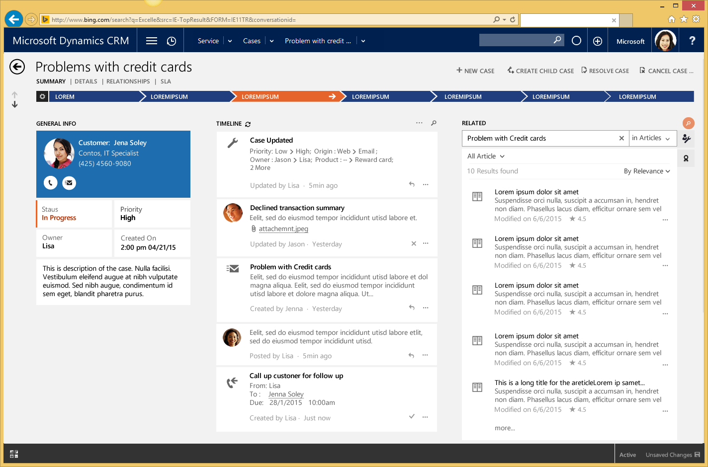
Interactive Service Hub
NEW
Role driven next-gen agent experiences (tailor-made for Customer Service personas)
Notes:
This new online user experience provides role based scenarios to deliver tailored application experiences for Tier 1 and Tier 2+ agents.
Tier One Dashboard: The interactive service hub comes loaded with a dashboard specifically targeted at Tier 1 agents. Agents can view and act on their workload across multiple data stream. The data streams can be from multiple entities and can be based on Views or Queues ( My Activities, My Cases, Cases in the Banking Queue etc). Interactive charts provide a visual representation of the work items and also double up as visual filters to allow the agent to slice and dice the data and not get lost in the clutter. An additional level of filtering is available with Global filters is also available. Customizers/Administrators can choose form four layouts to build these dashboards.
Real-time dashboard for a One-place view of workload
Interactive chart based visual filters
Configurable data streams for multiple entities
Perform Queue and Entity actions directly from Streams
Granular and customizable filtering criteria
Customizable display
Select 1 or more records of a stream and access quick commands to act on it.
Tier Two Dashboard: We will also provide a dashboard targeted to the Tier 2 Agent persona. It comes with a single data stream on the left which would typically show an aggregate view of cases relevant to the agent. The Tiles on the right side ( shown in blue) can be used to snapshots of information across queues or views that are of interest to the agent. The Agent can drilldown on a tile to see the actual records and navigate to a specific record. Like the Tier 1 dashboard , this also has rich visual Charts doubling up as filters.
Understand your data at a glance
With charts and tiles Quickly see changes and patterns to act effectively
Monitor Queue volume and drill down to see queue data thru tiles
Associate color-identifiers for cases in streams
Apply interactive visual filters and global filters to prioritize workload
Modern and intuitive form design: The case form design allows agents to find and act on data with reduced clicks and navigating. This design pattern extends to other entities such as Account and Contact, as well as activities. This is the case form which unifies customer interaction's and pulls together all related information of the case record to enable agents to be productive and view of what's most relevant at all times. The business process is further enhanced to show process stage information as a fly out. For easier recognition you can color-identify important data such as status and priority. The timeline (Interaction Wall) allows for rich time and record based filtering capabilities in combination with a fast search to find exactly what you are looking for. Quick actions on search result, allow you to perform every day functions with ease, such as Marking a task as complete or responding to a customers email. The Reference Panel is geared towards a highly configurable experience that allows you to always show relevant related data . See what were the recent cases of this customer, Eligible entitlement. With Knowledge integrated you can deliver solutions to customers across channels.
Customer 360 for a complete view of your customer’s touch points
Timeline allows a unified view of your customer’s interactions across channels
Engage directly with your customer from the timeline and create follow-up activities, set reminders..
With the Reference panel, search and act on related records without losing context of customer data and interactions
Integrated Knowledge at your finger tips
Redefined business process interactions
Use filters to quickly get to interactions necessary for action
Quick commands provide the ability to act on records without losing context.
Open and view records in tabs within the Reference panel and continue to maintain context of all record data
Recommended Articles surfaced on right pane through ML – add details in blurb about new form
POSTPONED – CSM Dashboard

Slide 12
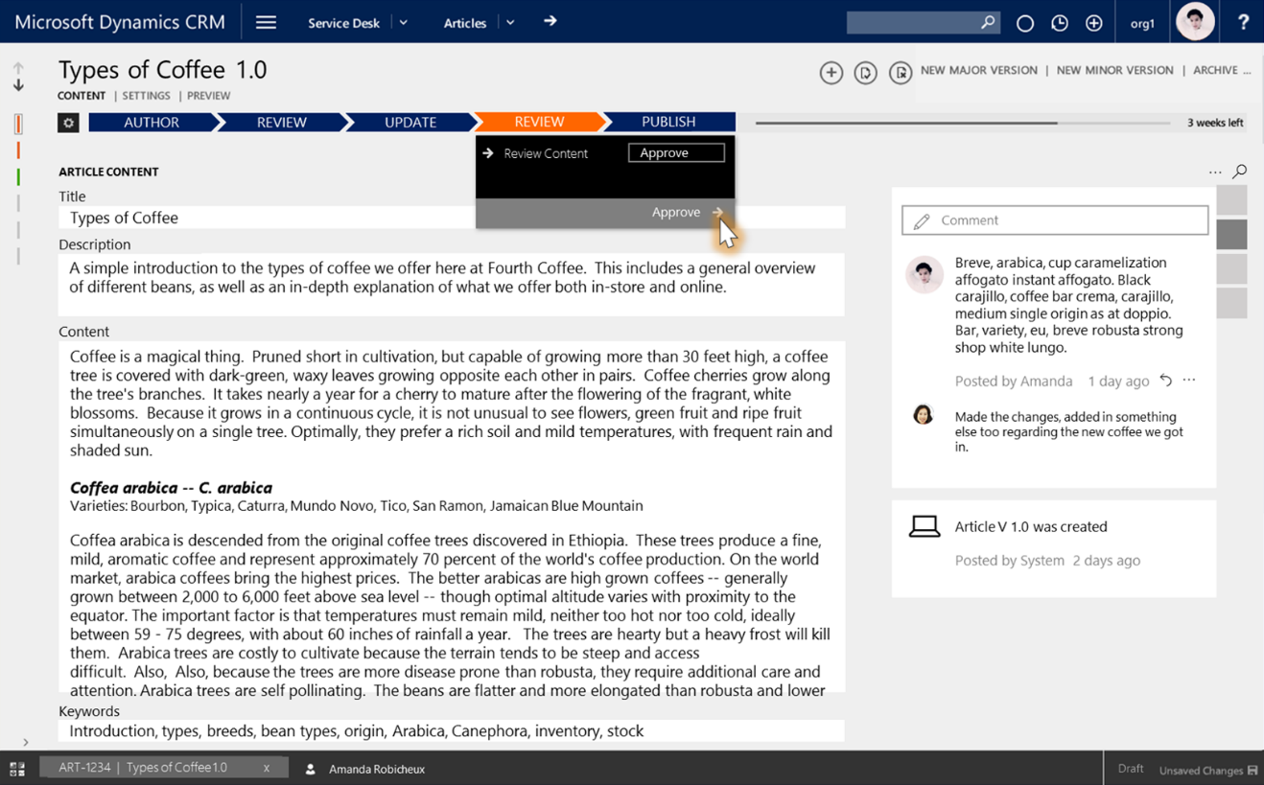
Knowledge Management
ENHANCED
Native KM solution for CRM
Simple, modern experience for creating knowledge
Translation and versioning to support enterprise knowledge lifecycle
Notes:
Enhanced knowledge base and global content model on xRM with KCS inspired workflows, platform support for article templates and new content types as well as enhancements to search across agent and customer facing queries.
Port existing Parature KB and global content model to xRM.
Enhance existing KB structure with KCS (Knowledge Centered Support) inspired workflow.
Develop platform support for article templates & new content types.
Optimize Search investments across Agent & Customer facing query

Slide 13
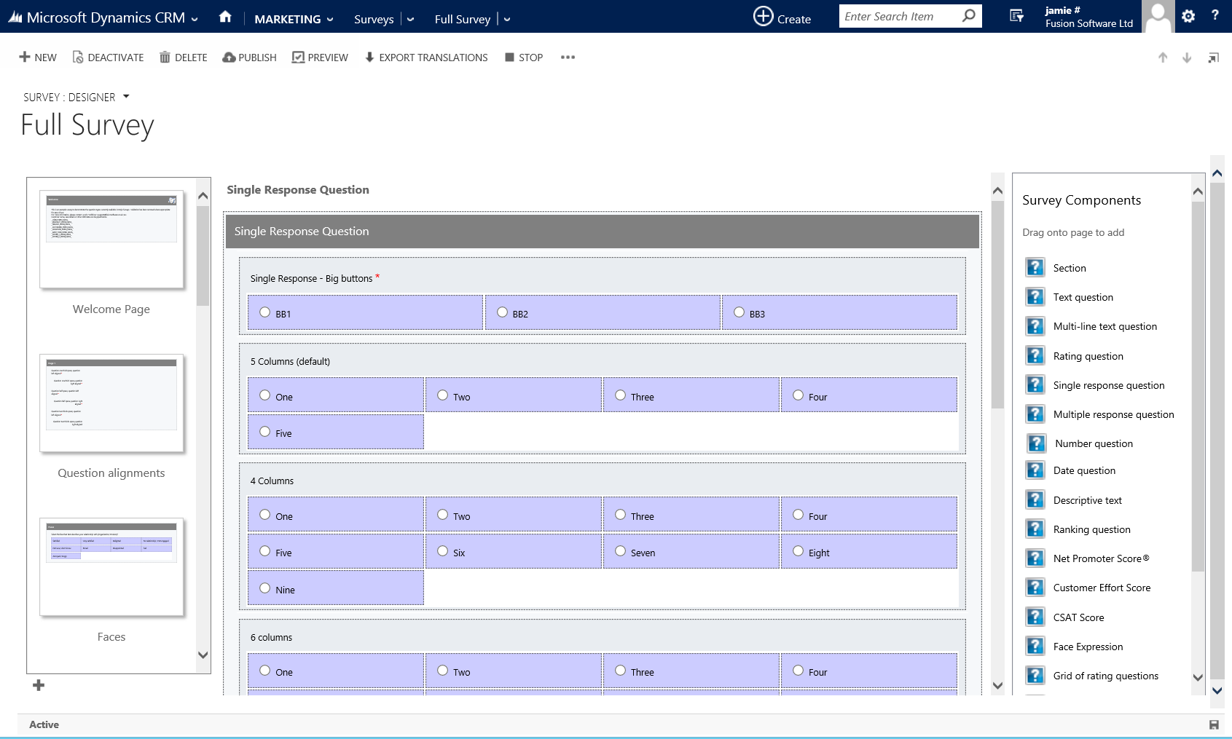
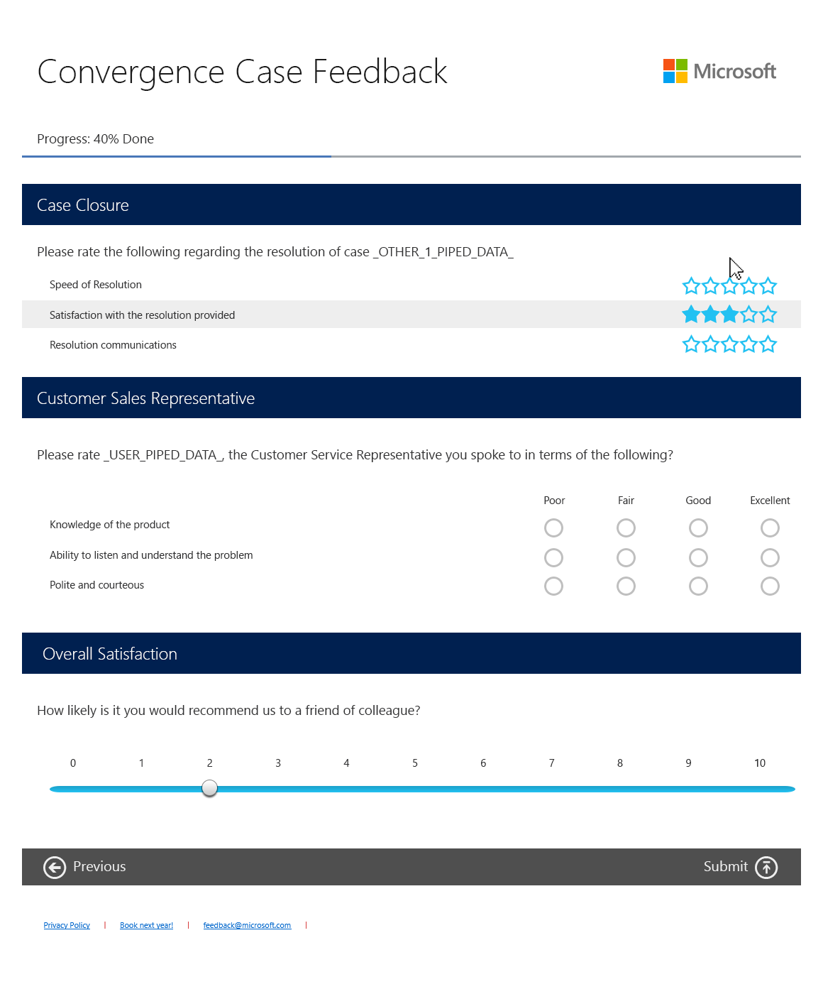
Voice of the customer
NEW
Out-of-the-box survey functionality
Capture and track responses directly in CRM
In-app designer with click to publish
Adaptive and touch friendly
Flexible distribution options
Notes:
New rule-based, multi-channel enterprise feedback management capabilities enable embedded voice of the customer insights into customer engagements.
Create, send and capture customer feedback natively from within CRM
A fully functioning designer that allows dragging and dropping of question types onto a form
Ability to show CRM data in the survey for a personalized experience
Client side logic to show/hide questions based on rules and data entered
Use basic as well as enhanced controls for improved usability
Adaptive and touch friendly UI flows across all devices including phones
Distribution channels include email to lead or contact, link or iframe within a webpage
Data validation to ensure format correctness (e.g. phone number format)
Results stored inside CRM against the relevant customer for a full view of all customer engagement
Integration with Net Promoter Score®
Online hosted surveys (requires azure to host feedback page)
Available for both CRM Online and CRM On Premise

Slide 14
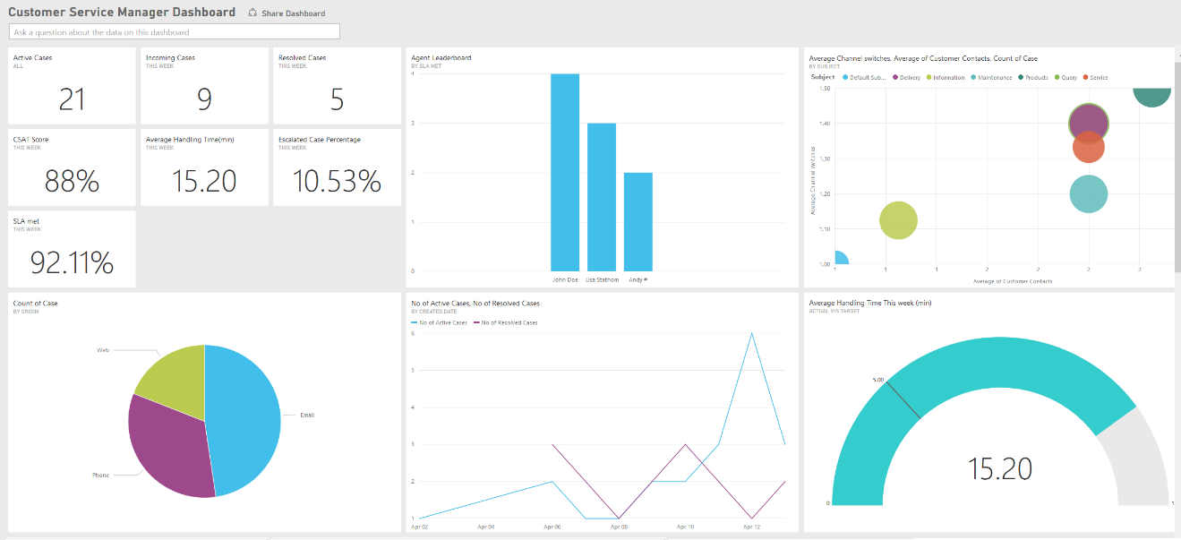
Service intelligence
NEW
Power BI customer service dashboard
Notes:
An interactive Power BI dashboard to provide Customer Service Managers (CSMs) with an aggregated view of customer service performance.

Slide 15
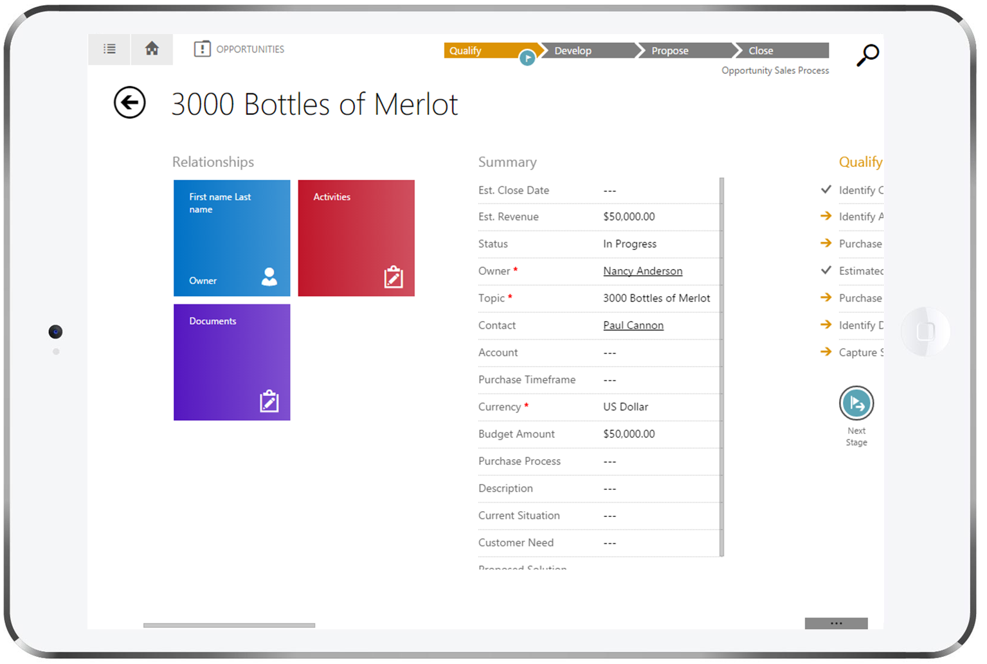
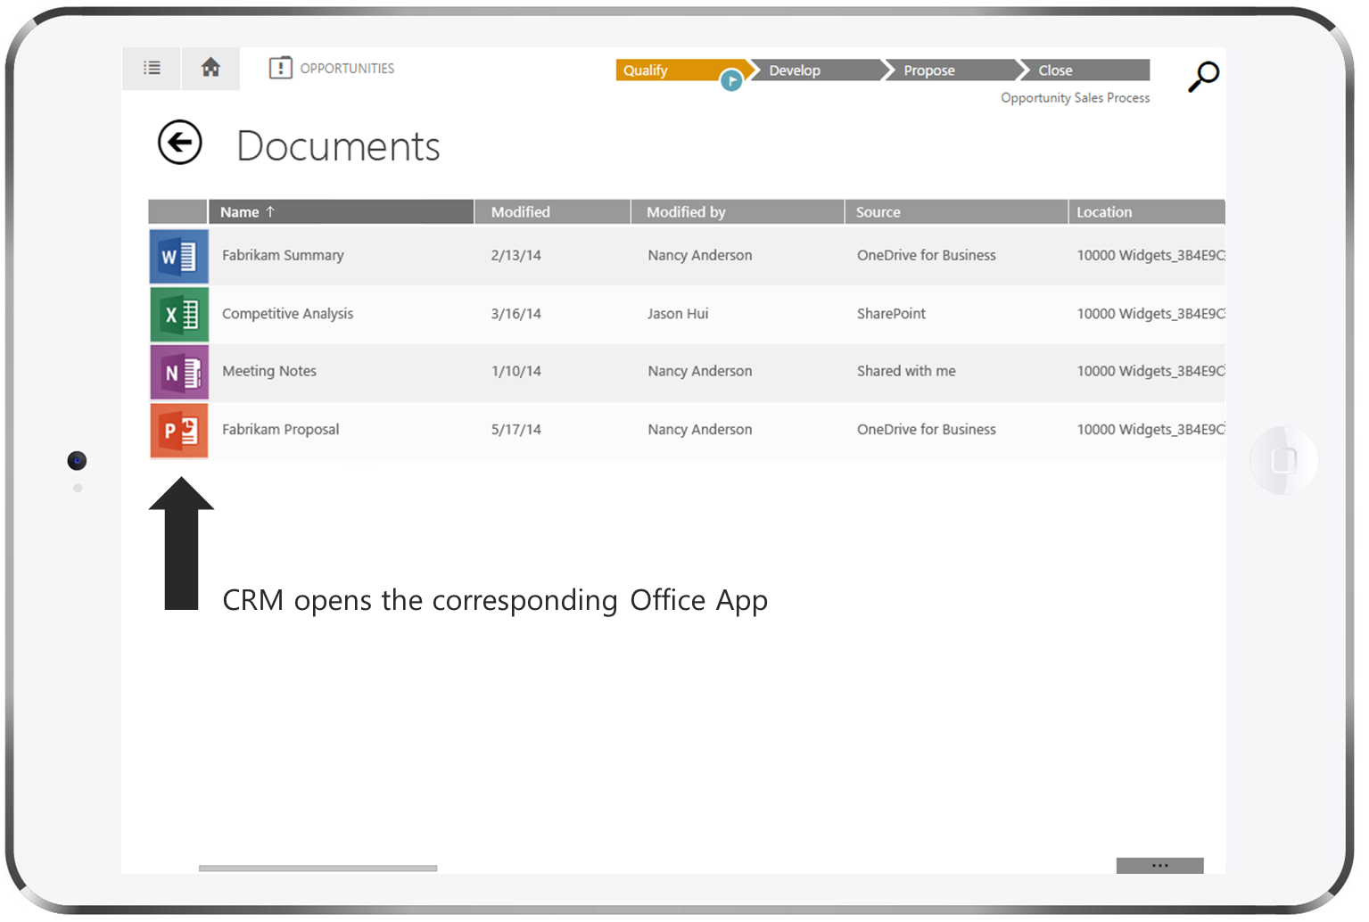
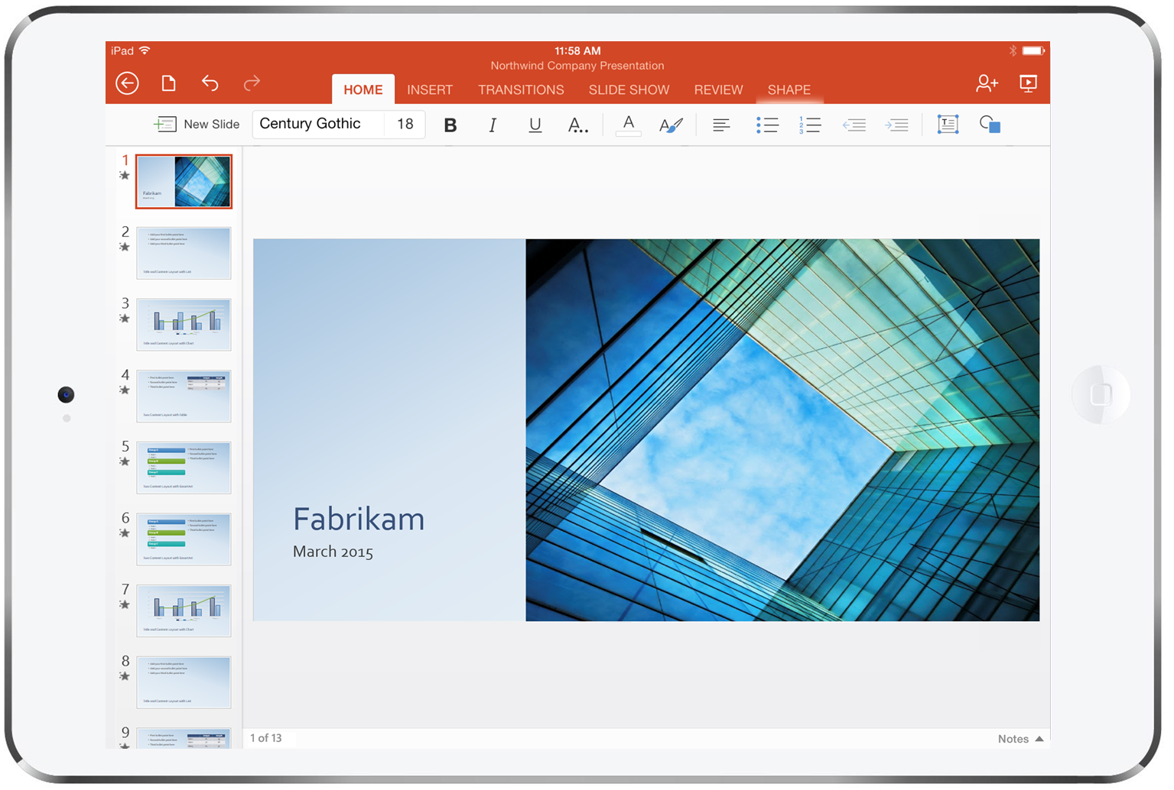
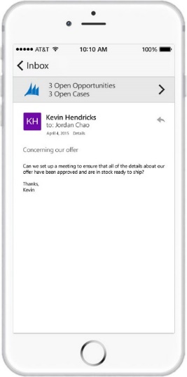
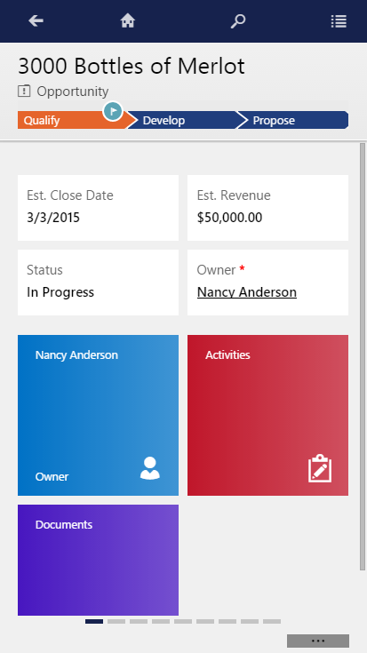
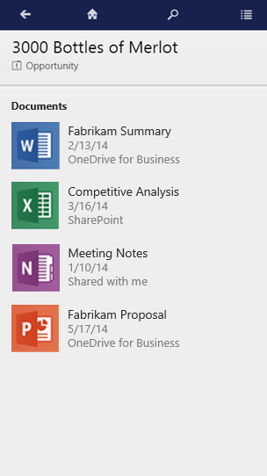
Document management
NEW
View documents in context of opportunity, case or any entity
Seamlessly integrates with Office for documents
View private documents on OneDrive for Business or team documents in SharePoint
Notes:
Fall release brings the document management in CRM to the mobile apps. This new feature allows you to view the documents from SharePoint or OneDrive for Business in context of a CRM record.
This is enabled through outbound mobile deep-linking allowing users to seamlessly open various Office apps within the CRM mobile app. For example, you can open a proposal document in the CRM app using Microsoft PowerPoint for iPad or Microsoft Word for iPhone as illustrated in the screenshots. After reviewing the document, you can return back to the CRM app by just tapping on the “back” button.

Slide 16
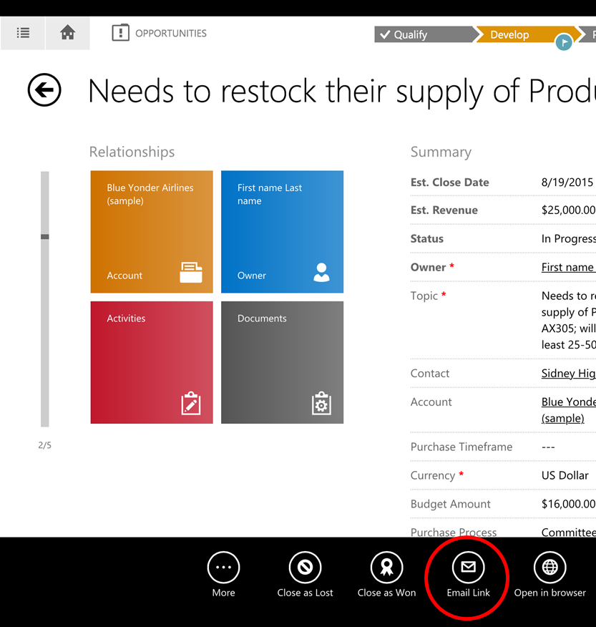
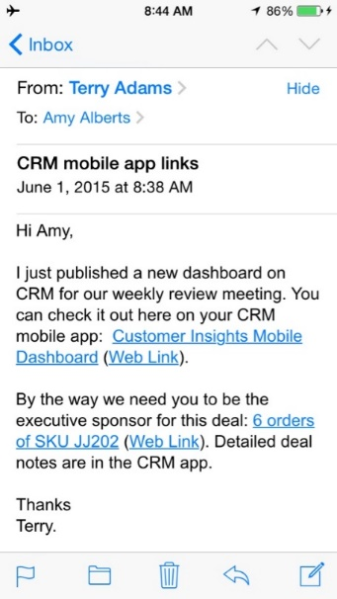
App-to-app deep linking
NEW
Deep linking directly to a record/view/dashboard in the CRM mobile app
Inbound links from other apps (email, mashups ) to CRM with mobile-specific URI
Built-in email sharing for apps
Notes:
Enables other mobile apps (such as email or your custom mashup apps) to link and directly navigate to a record/ view/ dashboard within the CRM mobile app. In simple terms, this provides a URL addressable form/view/dashboard for mobility.
This is achieved through mobile deep-linking using a mobile-specific URL such as ms-dynamicsxrm://?pagetype=entity&etn=[ETN]&id=[GUID].

Slide 17
App-to-app deep linking
NEW
ms-dynamicsxrm://?pagetype=<VALUE>&etn=<VALUE>&id=<VALUE>
ms-dynamicsxrm://?pagetype=entity&etn=account&id=91330924-802A-4B0D-A900-34FD9D790829
Examples
Notes:
Enables other mobile apps (such as email or your custom mashup apps) to link and directly navigate to a record/ view/ dashboard within the CRM mobile app. In simple terms, this provides a URL addressable form/view/dashboard for mobility.
This is achieved through mobile deep-linking using a mobile-specific URL such as ms-dynamicsxrm://?pagetype=entity&etn=[ETN]&id=[GUID].

Slide 18
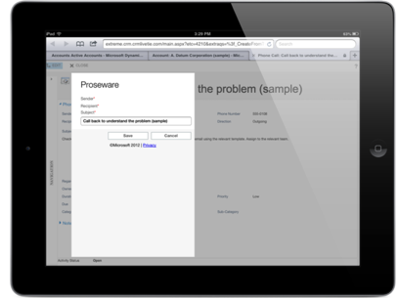
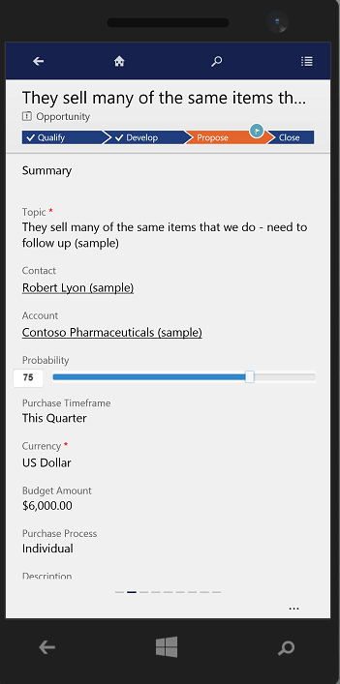
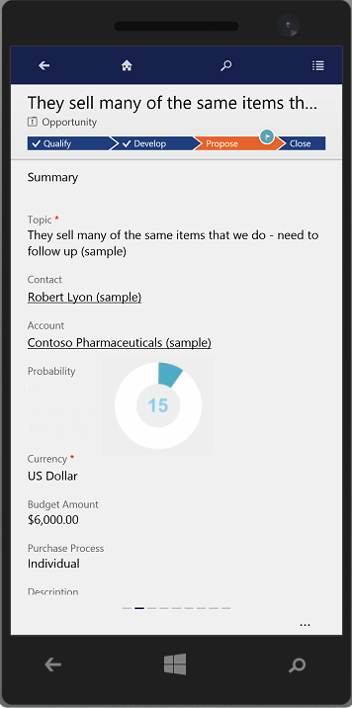
Modern mobile friendly experience
NEW
Rich set of visual and interactive controls
Enriches the UI for a touch friendly interaction
Provides immersive mobile experience
Notes:
With the fall wave, we’re adding a variety of UI controls you can use in the mobile apps. Business Analysts have the ability to bind a data field to a new UI control, representing the data in a visual and interactive way. Slider and calendar controls shown in the screenshot are just a few examples of the available control-set of 15 controls . The new controls work across all mobile clients (tablets & phones) providing an engaging and immersive mobile experience. For example, users can easily visualize date-related CRM information within a calendar.

Slide 19
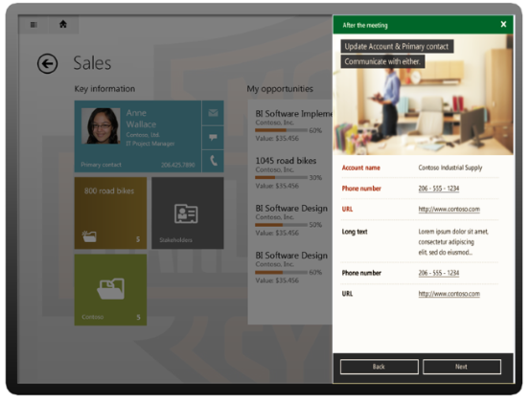
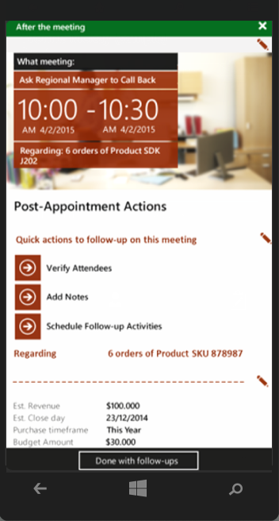
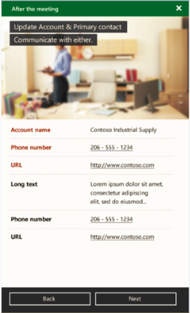
Task Based Experiences
NEW
Allows users to focus on the tasks they need to perform
Editable data from multiple entities brought together
Support for business logic and task branching
PREVIEW FEATURE
Notes:
When all you want is to be able to easily reach out to make contact on an Opportunity, you don't want to have to visit the involved records (Opportunity, Contact & Account), you want all the right information in one place, actionable at your fingertips. This is quick and easy with task based experiences in CRM.
Need to guide your users through a complex task? Want to ensure they are performing the right actions in the right circumstances? With branching logic determining which page is shown to the user, and business logic enabling data verification and UI updates you can easily help your user get through the task so it is completed efficiently and effectively, with little user effort.
New task based experiences are immersive experiences that allow users to focus on the tasks they need to perform, not the records they need to interact with. Data from multiple entities are brought together into a single user experience. As illustrated in the screenshots, task based experiences will be available on phones and tablets.
This functionality is planned to be available in Fall 2015 release wave as a preview feature. Preview features are not supported by Microsoft and will be available on an opt-in basis, only for Dynamics CRM Online customers.

Slide 20
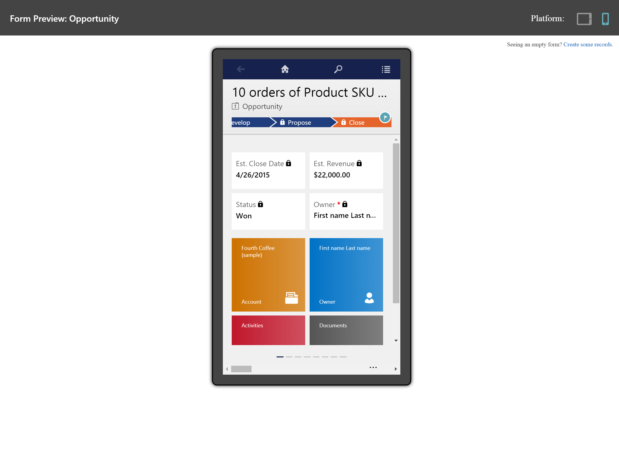
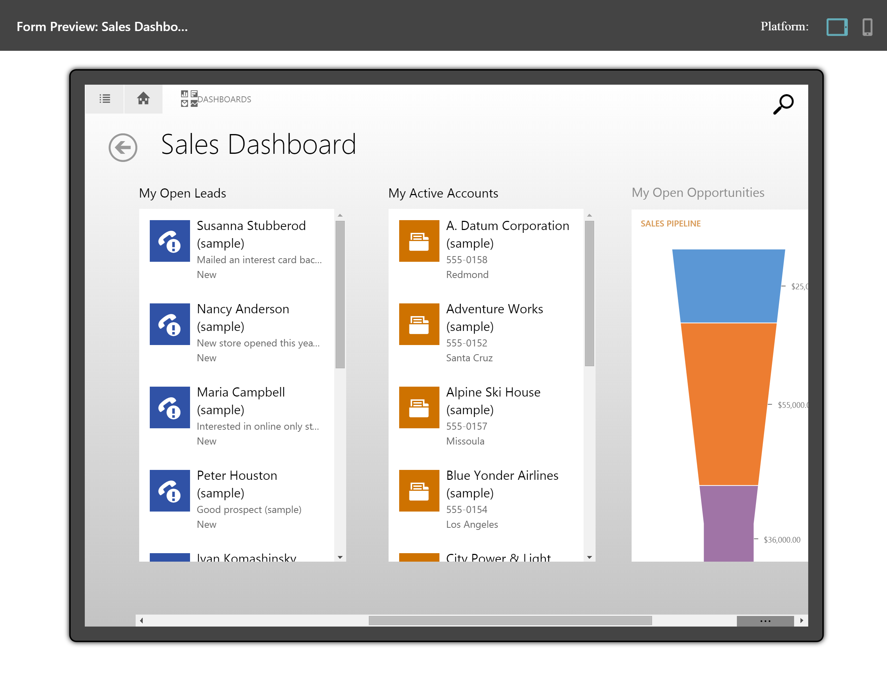
Mobile client form preview
ENHANCED
High-fidelity preview of the mobile forms and dashboards when editing and applying customizations
Full preview of both phone and tablet form factors
Notes:
With the “Configure once, deploy everywhere” paradigm at our core, we are simplifying the business analyst experience to easily visualize their configuration changes.
When designing forms in the CRM, you can now easily preview the tablet/phone forms and dashboards directly from within the browser.

Slide 21
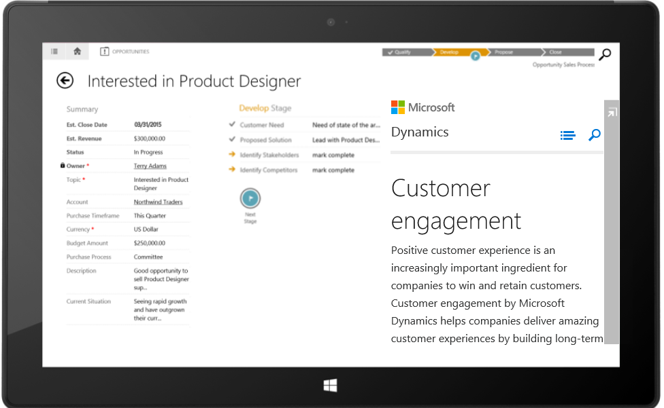
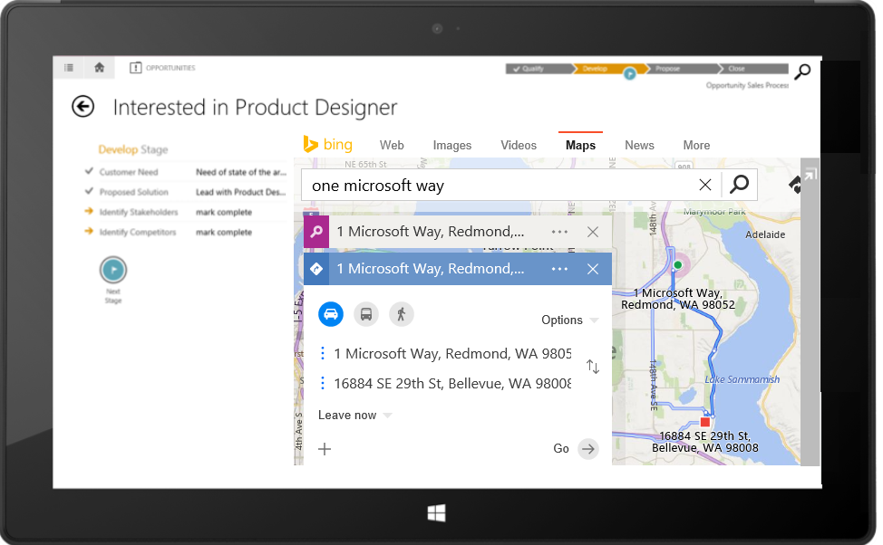
Web Resources and IFRAME
ENHANCED
Extensibility and Integration within tablet apps for CRM
Custom UI and logic using Web Resources
Composition of services using IFRAME
Mashups extended to Windows 10
Notes:
Last year, we introduced IFRAME and web resource support in CRM for tablets as a ‘preview’ feature - https://www.microsoft.com/en-US/dynamics/crm-customer-center/preview-feature-iframe-and-web-resource-support-in-crm-for-tablets.aspx
The feature will be generally available in the fall release and we’re also adding support for Windows tablets (Windows 10).

Slide 22


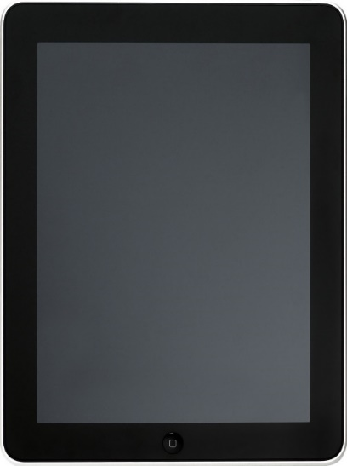
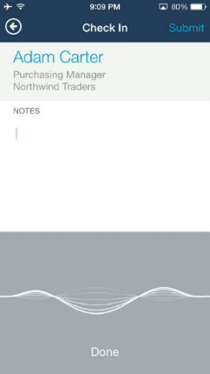


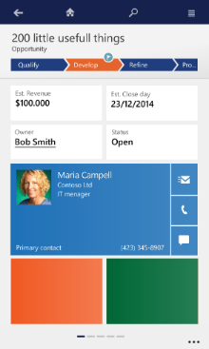
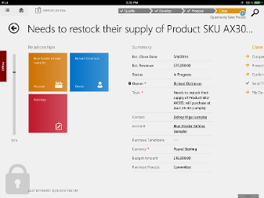





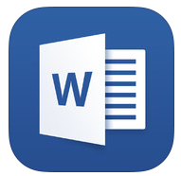
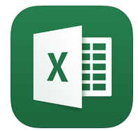



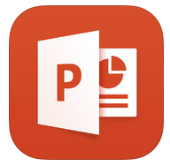

Mobile management
NEW
Personal
Protect enterprise data using Microsoft Intune
Policy Managed apps for iPad and iPhone
Corporate
LOB App #2
Microsoft
Intune
Notes:
In a mobile-first world, enhancing mobile productivity in a secure way is paramount to customer success. We’re extending our mobile management story with the integration of Microsoft Intune in the fall release. Customers will be able to secure the CRM data in BYOD (Bring Your Own Device) scenarios with Mobile Application Management (MAM) capabilities of Intune. This allows users to separate their personal data and corporate data on their own devices. The integration utilizes Intune App SDK and we’ll release policy managed (MAM-protected) apps for CRM in the respective appstore. Some of the capabilities of this integration include:
The CRM mobile apps can support Intune management policies such as:
PIN enforcement
Prevent data leakage on the device (for example, disable copy + paste to personal apps)
Enforce encryption of app data at rest
App-level selective wipe

Slide 23
Data encryption for CRM Online (server)
NEW
Full protection as the entire DB is encrypted
Keys are managed by Microsoft per Microsoft security policies
No code changes required and full compatibility
Full SQL Database Encryption
Data encryption at REST
Customer managed keys*
Customers control encryption strength and key management
No functional limitation
Planned as Preview Feature
Full SQL Encryption with Customer-Managed Keys
* PREVIEW FOR SELECT CUSTOMERS
Notes:
CRM Online today offers the ability to encrypt the full customer database leveraging the SQL TDE mechanism. This provides the ability to seamlessly protect the database without affecting any of the core capabilities of the product. In this scenario, the encryption keys used for database encryption will be managed by Microsoft. This is available today on demand.
While encryption the data at rest is great, a common ask from customers is the ability to have control over the encryption keys that are used for encrypting the database. This provides great control to the customer as it enables them change keys or revoke access on demand in a completely self-service manner. In this model, customers generate a key for encryption and upload it to a vault controlled by the customer. The CRM service then uses this key to encrypt the data for that specific customer.
Customer Managed Keys are planned to be available in Fall 2015 release wave as a preview feature for select customers. Preview features are not supported by Microsoft and will be available on an opt-in basis, only for Dynamics CRM Online customers.

Slide 24
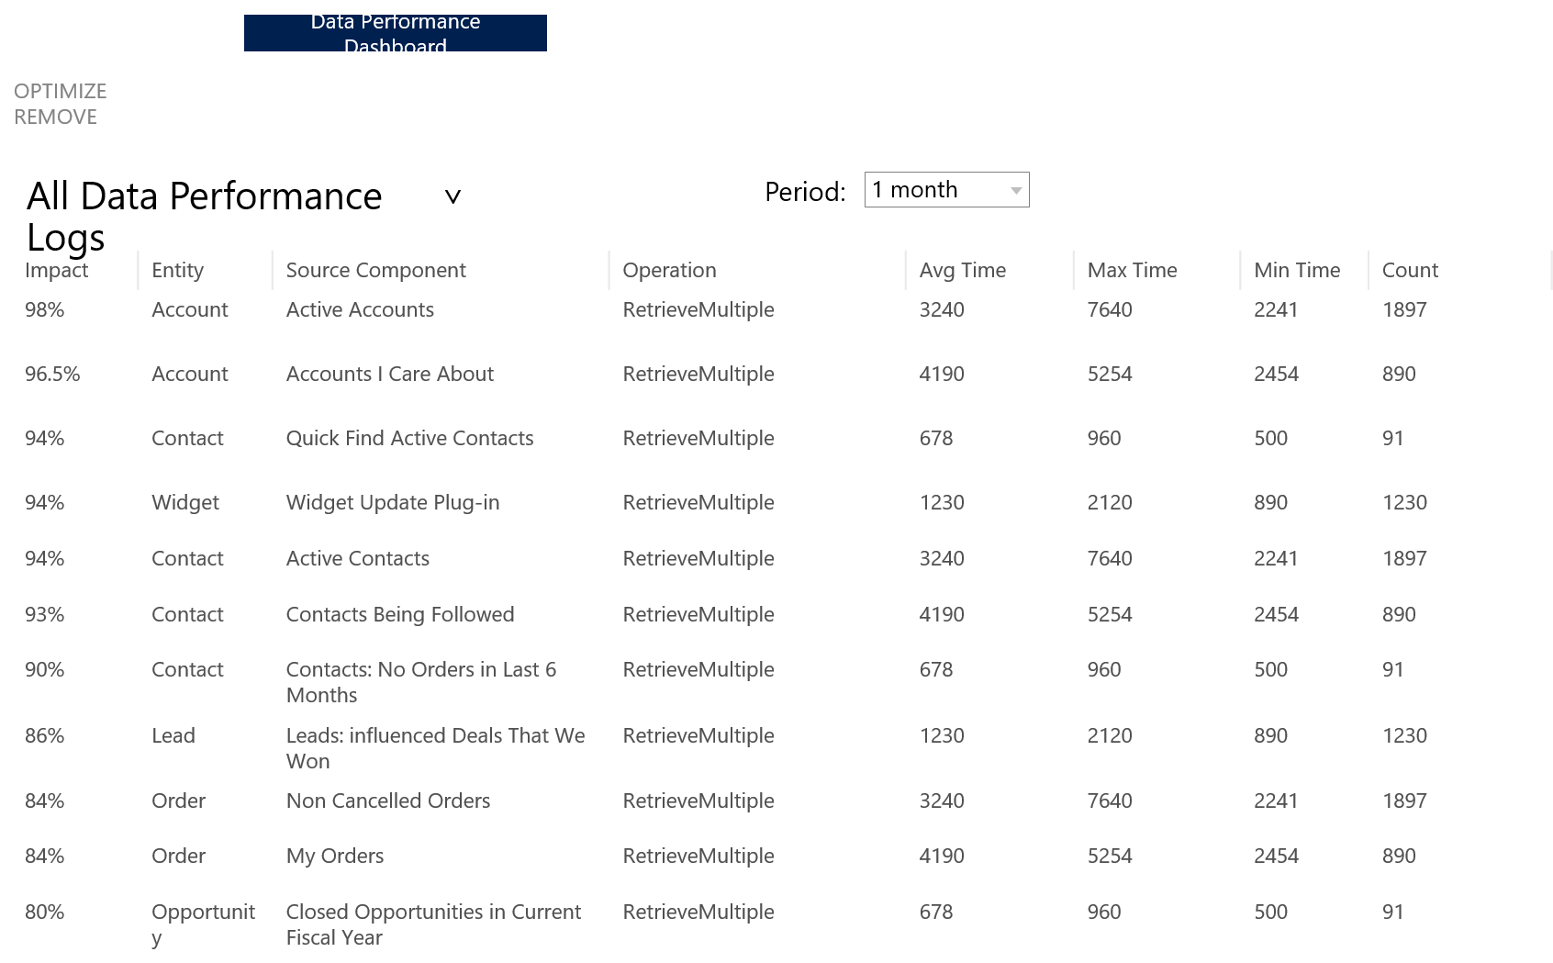
Data Performance Dashboard
NEW
Insight
Optimize
Assess
Admin driven optimization
Understand performance over time of components with long running queries.
Improve performance of components with optimization recommendations.
Assess how well existing optimizations are performing
Notes:
Admin Driven Optimization to:
Understand the performance over time of components with long running queries.
Improve the performance of components with optimization recommendations.
Assess how well existing optimizations are performing

Slide 25
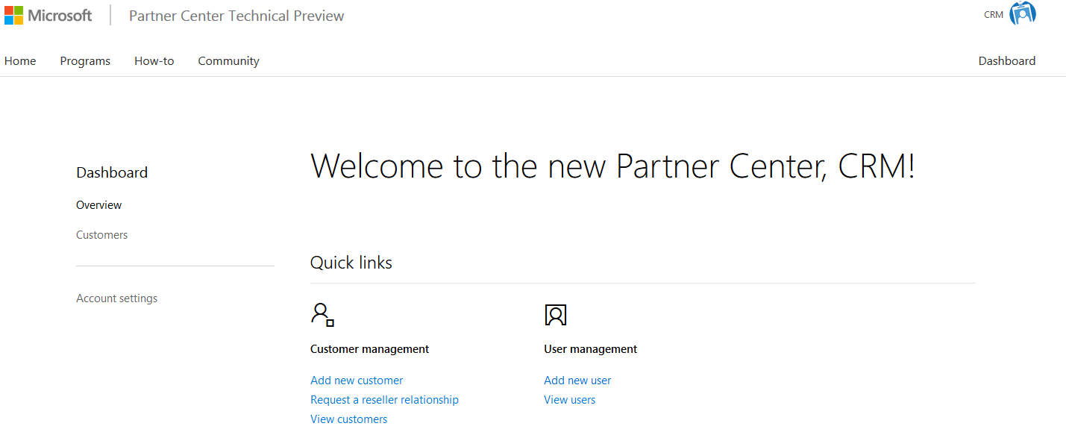


Cloud Solution Provider (CSP) with delegated admin
NEW
Shipped
July 2015
Own the customer relationship including subscriptions and billing
Service the complete customer lifecycle including provisioning, management and support
Attach partner services
Manage as a delegated admin directly from the new Partner Center for CSPs
Notes:
CSP is only available for CRM Online deployments.

Slide 26




Bulk Data Loader for CRM Online
NEW
Getting data in at high-speeds into CRM Online
Designed to handle large volumes with data staging and validation
Support for scheduling, import
CRM Online
SDK
Platform
Staging DB
PREVIEW FEATURE
Notes:
Bulk Data Loader for Dynamics CRM Online is a new cloud service built by the Dynamics team. The main purpose of this service is to enable bulk import/export of data into Dynamics CRM Online. This tool will allow uploading large data files to cloud staging tables where you can perform lite data quality functions and then push the data into CRM Online. This service will also support recurring data import/export. The Bulk Data Loader will be accessed from a link on the CRM Admin Center website that will redirect users to Dynamics LCS (Life Cycle Services) website (https://lcs.dynamics.com).

Slide 27

New datacenters
ENHANCED
Datacenter expansion to Canada and India
Notes:
Let’s first take a look at the broad reach that you gain by leveraging Dynamics CRMOL. Across the globe we currently have datacenters deployed in global regions including North America (East/West/South), European Union (Ireland/near Amsterdam), Asia-Pacific (Singapore/Hong Kong/Japan), Australia and South America (Sao Paulo, Brazil).
These regional datacenters provide CRMOL to 44 countries around the world in 130 languages and we continue to evaluate new markets. Most business are unable to attain this level of reach and localization with internally built applications as it becomes cost prohibitive. If you compare CRMOL with similar products in market you will find that we have the broadest geographical reach with datacenters closest to the customer to avoid latency issues.
In addition, we localize in many more languages than any other provider, and make them available at no additional cost (link to Salesforce localization). Today our top competitor has locations in US, UK, and Japan only. Those datacenters are not owned by them but they host their infrastructure in those geos. With Microsoft we are either building or leasing space for our datacenters and our investments are vast.
For those we build they are solely owned and operated by Microsoft. For those we lease, in many cases we are upgrading the network and facilities and placing our hardware.
For specific information on which countries are serviced by which regional datacenter can be found here.
For specific information on which languages we localize in and countries we sell into visit this link.
Our internal teams manage the CRMOL infrastructure utilizing their depth of experience and knowledge of delivering cloud and datacenter services for more than 23 years. Our first datacenter was established in 1989. Since then, we have run some of the largest global services securely and efficiently – Bing, Office 365 and Hotmail just to name a few. Today, we run over 200+ global services 24x7.
FUTURE:
The Microsoft Canada geography consists of the Canada East Region (located in Quebec City, in the province of Quebec) and the Canada Southeast Region (located in Toronto, in the province of Ontario). The Microsoft India geography consists of the Northwest Region and the Southeast Region (specifics on the cities TBD).
With the inclusion of datacenters in Japan and Australia which recently went live, and our announcement of intent to expand into India, our global customers will be from datacenters located in 9 global regions around the world. More information on our datacenter locations can be found here.

Slide 28
Compliance and data protection
ENHANCED
CRM Online compliance
Certifications / audit reports
Agreements
Industry and Government requirements
Certification | Customers
SSAE 16 SOC 1 | All
EU Safe Harbor | EU
ISO 27001 | All
ISO 27018 | All (guidance)
SSAE 16 SOC 2 | All
Agreement | Customers
EU Model Clauses | EU
HIPAA - BAA | Health Care
DPA | All
FSI Program | Financial
Artifact | Customers
IL 2 | UK Government
CRM for Govt | Public Sector
CJIS | US State/Local
FedRAMP | US Federal *government cloud only
IRAP | Australia
MTCS | Singapore
Additional certifications and industry/government requirements
Highlighted areas are on the roadmap targeted for completion in the next 12 months.
Notes:
Continuing with our effort to be transparent, we have established the CRM Trust Center as a single location for you to access all information regarding our approach to security and compliance. Each time we receive a new certification information will be posted at this location. We have achieved a number of industry certifications which ensure that we are meeting the appropriate regulatory and country requirements.

Slide 29

Guided user experience
NEW
Azure cloud service
Across devices
Context sensitive guidance
Data driven
Proactive intervention
Notes:
Data driven guided user experience service (designer & runtime) to deliver content specific to your app, user context, location or device (phone, tablet, pc).

Slide 30
Modern web API
ENHANCED
OData Query
OData Metadata
JSON
OAuth
HTTP
Open and standards based makes it easy to consume from non-Microsoft stack
Complete enablement of oData V4 endpoint that includes support for CRUD and additional actions
Dynamics CRM
Notes:
One of the most critical aspects of any business application is a strong API that allow for the development of 1st and 3rd party client experiences and enables integration with other systems. Dynamics CRM has always provided this capability, and had evolved it to leverage the best technology available as the industry landscape has evolved. This feature aims to take the next step in that evolution and provide CRM with an API capability that matches to today industry norms, serves our broad set of constituents, and puts the product is a position to succeed wildly.
Dynamics CRM will provide web API that leverages the most broadly adopted industry standards for protocol (HTTP and REST), security (OAuth 2), format (JSON), and expose it’s rich set of data capabilities via open industry standard OData v4, recently approved by OASIS and the standard for new web services created by Microsoft. This approach moves us from a .NET focused set of capabilities to a position of being open to the wide variety of technology platforms that power our industry today.

Slide 31

Ecosystem enablement
NEW
Solution segmentation for better manageability
Solution patching support
Performance and reliability
Notes:
Solution Improvements:
Allow for sub-components of a Solution Package
Patching support
Lifecycle Improvements for Integration with the Marketplace
Parallelization of deployment

Slide 32

Next generation search
ENHANCED
Modern search experience
Cross entity relevance in results with hit highlighting
Full text search term matching
Notes:
Single list of results across entity sorted by relevance to the search text. Match to any word in search across any search enabled field in any search enabled entity.
When available as part of the fall release, this new search capability will be off by default for everyone. Once enabled end users will still have the existing multi-entity Quick Find experience, which we’re now call Categorized Search, available in the UI.

Slide 33




Azure Machine Learning
NEW
Cross-sell Recommendations
Topic Analysis
Suggested Knowledge Articles
PREVIEW FEATURE
Notes:
Fall release brings scenario based integration with Azure ML for product cross-sell recommendations and suggested knowledge articles with text analytics. Azure ML integration offers configuration experience and insights integrated into CRM UI removing complexity of requiring data scientists or understanding ML models.
To be released as a preview feature for North America CRM Online customers.

Slide 34
Demonstrations

Slide 35
Questions?

Slide 36
Thank You

